Slide 1
EVALUATIONS THAT CHALLENGE THE STATUS QUO: USE OF STATISTICAL TECHNIQUES IN MEASURING ADDITIONALITY
Australasian Evaluation Society International Conference
Sydney, Australia, 29 August – 2 September 2011
Michele Morris¹ Pene Greet² Oliver Herrmann² Kris Iyer² Philip Stevens²
¹ New Zealand Ministry for the Environment
² New Zealand Ministry of Economic Development

Slide 2
Overview
Evaluation of publicly-funded research and development grants
New wide-coverage business database
Statistical techniques
Counterfactual / control group
Results and conclusions
Limitations and related evaluations

Slide 3
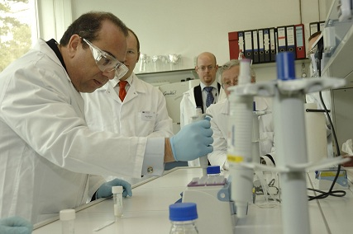
Policy objectives and grants
Increase and enhance the R&D.
Increase the economic performance.
Two different types of government R&D subsidies
assistance to build R&D capability
assistance for R&D projects
Assisted firms
larger
higher sales
capital intensive
exporting and
undertaking R&D

Slide 4
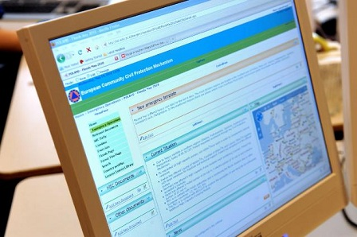
Prototype Longitudinal Business Database (LBD)
High quality and comprehensive firm-level data (micro-data) from 2000 to 2008.
Linking administrative and survey information
financial performance
employment
merchandise trade
business practices
government assistance

Slide 5
Statistical techniques
Changes in performance of assisted firms to matched similar New Zealand firms.
The additional impact
result of the public subsidy alone
impact due to other factors that also affect firms’ performance
Comparing actual and counterfactual outcomes.

Slide 6
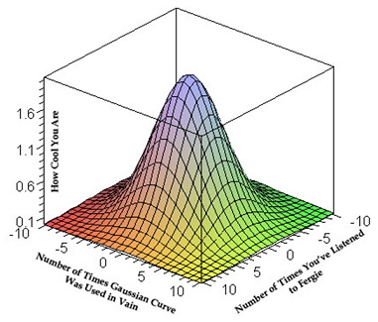
Counterfactual

Slide 7
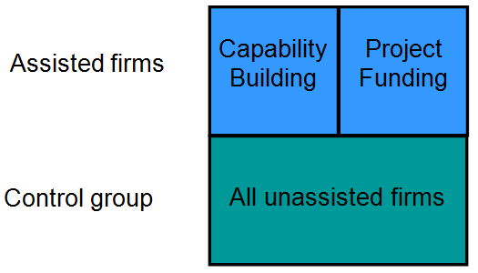
Control group and matching variables
Employment and change in employment
Total productivity and change in total productivity
Capital intensity and change in capital intensity
Exporting industry
Firms in group
Firm age
R&D activity
Ownership status

Slide 8
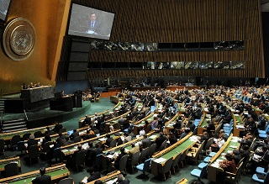
General results
Significant impact on economic performance of the firms due to the R&D subsidies.
Impact is less than that measured by related evaluations.
“Capability Building” has a positive impact on employment growth, sales, value added, and productivity.
Counterintuitive finding: No impacts for “Project Funding” !

Slide 9
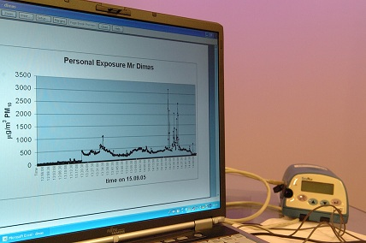
Detailed results
Influence of firm size and prior R&D activity on the results?
Positive impacts for small firms.
Positive impacts for firms that had not undertaken R&D two years prior to receiving their assistance.
No impacts for large firms and no impacts for prior R&D performers.

Slide 10
Conclusion
Government R&D subsidies have a significant positive impact when they are targeted at firms
that are building capability;
that are small;
that have not previously undertaken R&D.
No impacts for large firms.
No impacts for prior R&D performers.

Slide 11
Limitations and related evaluations
Data limitations (4 years)
Previous evaluations (case studies and surveys) showed very positive outcomes.
Before/After comparison (completion of the grant) does not inform about any additional impact.
Most previous evaluations have overestimated the economic impact.
Our methods address this question by comparing the performance of an assisted firm to a matched similar firm.

