Slide 1


A Vision for Indigenous Evaluation
Nan Wehipeihana
Keynote Presentation
Australasian Evaluation Society 2013 Conference
3 September, Brisbane, Australia

Slide 2
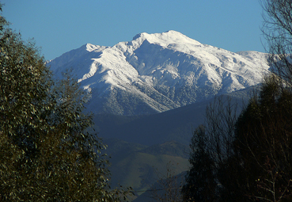
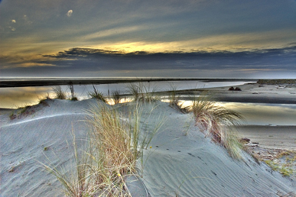
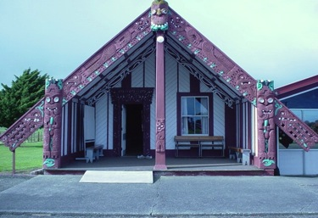
Ko Tararua te pae maunga
Ko Ohau te awa
Ko Tukorehe te marae
Ko Ngati Tukorehe te iwi
Tuku mihi
ki nga kaitiaki o tenei wahi e noho mai nei
ki nga tohunga me nga whare takuira
ki a koutou katoa no nga hau e wha
Notes:
To the indigenous peoples of this land
To the ‘traditional owners’ guardians of this land where we gather today
To their traditional knowledge holders/ and to their ‘houses’ of learning
To all here today from near and far

Slide 3
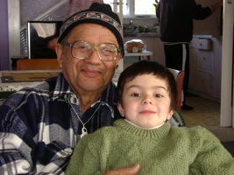
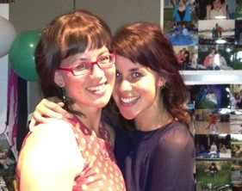
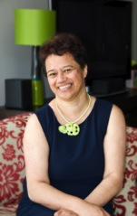
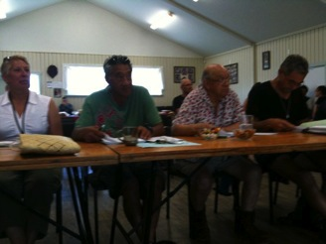
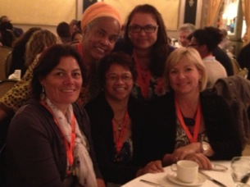
Who am I?
(Ko wai au?)
Notes:
Ngahorihori NAN Wehipeihana
Mother of two
Tribal trustee
Evaluator
Bridge and dancing

Slide 4

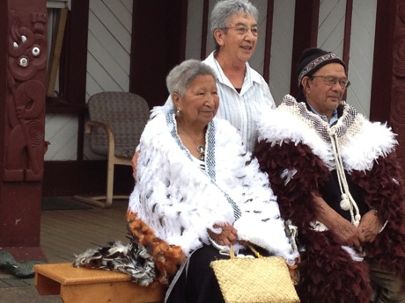
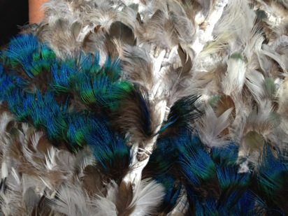
My motivation to do evaluation…
Make a positive difference for Māori
Tukorehe Marae Jan 2013, Wehipeihana whānau reunion
Surface Māori values and perspectives
Notes:
“I am motivated to do evaluation that makes a positive difference for Māori – the Indigenous people of Aotearoa New Zealand. For me, it’s about providing an understanding of what it means to be Māori as well as surfacing Māori aspirations; and it’s about the potential to influence policy, programme development, and service delivery so Māori views, perspectives, and interests are elevated in decision-making.
In my practice I support, and advocate for evaluation that is culturally grounded, enabling, and affirming of Māori values and views. I consciously look for opportunities that offer the potential to grow Māori understanding of government processes, support and facilitate Māori participation in decision makingas well as governments’ understanding of Māori values, views and priorities (Wehipeihana, Pipi, Kennedy & Paipa, 2013).

Slide 5
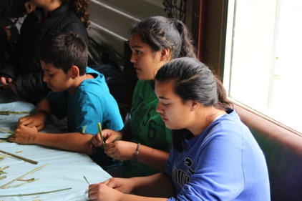
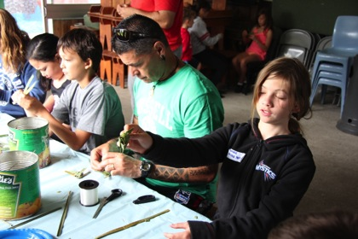
My values orientation in evaluation…
Manaakitanga
An ethic of care
An ethic of responsibility
Tukorehe Marae Jan 2013, Wehipeihana whānau reunion
Who I am
How I see the world
My evaluation practice
Notes:
My motivation to make a positive difference for Māori through evaluation comes from the examples of manaakitanga (an ethic of care and service) modelled by my parents. My parents were on church committees, tutored kapa haka (cultural dance and performance), supported the establishment of urban marae (meeting places) and te kohanga reo (early childhood Māori language centers), were involved in marae and iwi activities, provided emergency and short term foster care for children and both worked full time.
So for me, part of what it means to be Māori is an ethic of service, a responsibility to use whatever skills or talents I have to contribute to whānau (extended family), hapū (sub tribes) iwi (tribes), community and Māori well-being, albeit in ways that are different from the examples set by my parents. This ethic of care, an ethic of service is inextricably linked to who I am, how I see the world and how I practice as an evaluator.

Slide 6
My values orientation in evaluation…
I seek to use the tools and the discipline of evaluation
To critique policy, programs and service provision by Government, by mainstream non-Māori organisation and by tribes and Māori organisation.
To contribute to a more just, equitable and inclusive society
Notes:
I am clear about my orientation, my stance towards evaluation.
I seek to use the tools and the discipline of evaluation to critique policy, programs and service provision by Government, by mainstream non-Māori organisation and by tribes and Māori organisation.
So from my perspective, what is the purpose of our evaluative endeavour if not to contribute to a more just, equitable and inclusive society; And in the lives of Māori and other Indigenous peoples, evaluation by implication therefore helps to redress the balance, right the wrongs, and foster equity of outcomes. It is about the supporting the meaningful inclusion and participation of Māori and Indigenous People in the determining of what matters and what’s important for their own wellbeing.

Slide 7
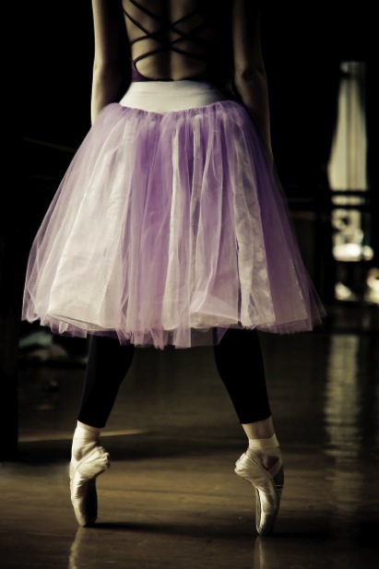
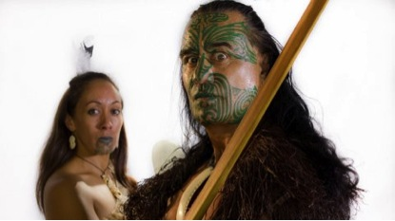

Tutu meets Tatoo
A vision for Indigenous Evaluation for AES
Photo: Māori Television
Photo: Bigstock
Notes:
My vision for Indigenous Evaluation is one where manaakitanga (an ethic of care) prevails and evaluators and evaluation associations have a deliberate ethic of care when evaluating with and in Indigenous communities. It’s a vision where whanaungatanga (relationships and the building of relational trust) ‘are the business’ of evaluation and at the forefront of our evaluation design and methodological debates and decisions. And it’s a commitment to tino rangatiratanga (self determination) the way in which our practice and evaluative judgements take account of and respond to the aspirations for Indigenous peoples to be self determining.”

Slide 8
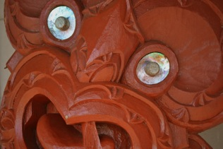
My conception of Indigenous Evaluation
  By Indigenous peoples
  For Indigenous peoples
  As Indigenous peoples
Non Indigenous participation is by invitation
No automatic or presumed right of participation
Photographer: Sharon Hawke
Notes:
My conception of Indigenous Evaluation
Evaluation led by Indigenous people
Evaluation for Indigenous people
Evaluation as Indigenous people – Where Māori approaches and methods are the norm and where non-Māori or Western approaches and methods need to earn their place.
In my conception of Indigenous Evaluation there is no assumed role for non-Indigenous peoples and the participation of non Indigenous peoples – if there is any - is by invitation only
A pipe dream? A step to far? An impossibility?

Slide 9
So how do we get there?
Paradigm shift
Fundamentally about how you view the world
Challenge
  For non-Indigenous
  Have to want to
  Have to see a reason to
  See the world differently
  Through ‘alternate’ eyes
  So why should I care – and how do I change?
Photographer: Sharon Hawke
Notes:
So how do we get there
Paradigm shift: This is It’s not about what you do; how you do it, fundamentally about how you view the world and how you know things
The challenge: But you need to want to be; have a reason to see the world through alternate eyes, do things differently.
Why should I care (and how do I change)

Slide 10
Why should I care?
Social justice – in the tradition of Greene (1997) House and Howe (2002) and Mertens (2008)
Ethic of care / do no harm – fundamental principle
Heart of our practice as evaluators – multi cultural validity (Kirkhart, 2005 & 2013)
Notes:
Why should I care (and how do I change)
Social justice (Greene, House, Mertens) We as evaluators have been doing evaluation, earning a living and yet we see no visible difference in the outcomes for Aboriginal peoples. Negative Stats
Ethic of care - do no harm - example where evaluation has or continues to do harm to Indigenous peoples
Multi cultural validity (Kirkhart, La France, Nichols)- centring validity arguments in culture (Kirkhart, 2013); validity located within culture, context and values;

Slide 11
How do I change?
Paradigm shift
Western paradigm | Indigenous paradigm
Destination | Journey
Evaluator as expert | Community as expert
Power and control Evaluator in control – sharing of power – Indigenous control
Paradigm shift reflected in our practice, our ways of working …
Notes:
Change our practice. Paradigm shifts reflected in evaluation practice, our ways of thinking, ways of working.
Paradigm 1 Western paradigm of destination (timeframes, deadlines, just need to get it done, get it out the door--> Paradigm shift where we begin to see the journey as the destination and our ways of working show that we understand process matters, relationships matters and tending to relationships is the core business of evaluation
Paradigm 2 Western paradigm of Evaluator Expert – spent many years, our identity and sense of self to a lesser or greater extent is linked to our professional and personal identity, our credibility as an evaluator. So we know some stuff about evaluation --> paradigm shift of valuing of Indigenous and community expertise (note diminished currency of some evaluation skills, expertise and experience that don’t have the same currency, don’t have the same value. That knowledge of community, expertise in navigating community
Paradigm 3 Western paradigm contract holder / evaluation leader (power and control) but the broader issue is about who decides, what’s appropriate, what speed we go, who we use, Who makes those calls; power sharing. So the paradigm shift we would hope to see is a greater sharing of power … dare I say and ultimately a giving up a handing over of power and control to Indigenous peoples.

Slide 12
How would we know things are on track?
Notes:
How would you know that things are on track to get there

Slide 13
Western imposed
“You decide”
Indigenous
Self-determination
“I decide”
Invitational space
Notes:
Outline the evaluation continuum
- Western Worldview To/For
- Indigenous Worldview By/As
Intersection | with |

Slide 14
Good results
For Canberra (VfM)
For community
Consequences
Western imposed
“You decide”
Indigenous
Self-determination
“I decide”
Invitational space
Harm
No change
Ineffective
Costly for taxpayers
Costly for community
Notes:
Consequence – Good results …. Do harm

Slide 15
Good results
For Canberra (VfM)
For community
Consequences
Western imposed
“You decide”
Indigenous
Self-determination
“I decide”
Invitational space
Harm
No change
Ineffective
Costly for taxpayers
Costly for community
TO
Notes:
Evaluation done TO - we’re doing it to you – we are the experts, we know what you need. Blind ignorance of the power and control issues | Western worldview dominates

Slide 16
Good results
For Canberra (VfM)
For community
Consequences
Western imposed
“You decide”
Indigenous
Self-determination
“I decide”
Invitational space
FOR
Harm
No change
Ineffective
Costly for taxpayers
Costly for community
TO
Notes:
Evaluation done FOR - we’re doing it for you – you know that there is a problem, good intentions, but benevolent colonialism | Western worldview prevails

Slide 17
Good results
For Canberra (VfM)
For community
Consequences
Western imposed
“You decide”
Indigenous
Self-determination
“I decide”
WITH
Invitational space
FOR
Harm
No change
Ineffective
Costly for taxpayers
Costly for community
TO
Notes:
Evaluation done WITH - we’re doing it with you - beginning of different ways of thinking, beginning of power sharing, cultural safety, culturally responsive, partnership, respectful
But with is a continuum
AT the WW (with you but within our western frame) non-Indigenous still largely in control
AT the IW (with you but within an indigenous frame) non-Indigenous playing much more of a supportive role, Indig Evaluators largely in control

Slide 18
Good results
For Canberra (VfM)
For community
Consequences
BY
Western imposed
“You decide”
Indigenous
Self-determination
“I decide”
WITH
Invitational space
FOR
Harm
No change
Ineffective
Costly for taxpayers
Costly for community
TO
Notes:
Evaluation done BY - Indigenous Evaluators leading, cultural values, principles and methods etc evident but still some accommodations of Western approaches for credibility, accountability | Increased World views seen as valid and valuable

Slide 19
Good results
For Canberra (VfM)
For community
Consequences
AS
BY
Western imposed
“You decide”
Indigenous
Self-determination
“I decide”
WITH
Invitational space
FOR
Harm
No change
Ineffective
Costly for taxpayers
Costly for community
TO
Notes:
Evaluation done AS - Indigenous Evaluators/people leading, Indigenous world views and methods prevail are seen as credible in an of themselves | Indigenous world views, knowledge's and ways of working dominate
On track... movement into the WITH space
Locus of control – individual being autonomous – shift from the indivdiual to the community as locus of control
People identified as individual practice - - - systemic level consequences
To and For – who funds you…; it is a systemic dynamic . . . A do it to them approach – practice is embedded in a Western system…
Power and consequence matriix

Slide 20
Tutu meets Tatoo¹
A vision for Indigenous Evaluation for AES
Photo: Māori Television
Photo: Bigstock
Notes:
Moko is the Māori word for tatoo – and cultural implies more then just ‘body art’. Tatoo is retained here because it speaks to / and was the language used at the time of the performance.

Slide 21
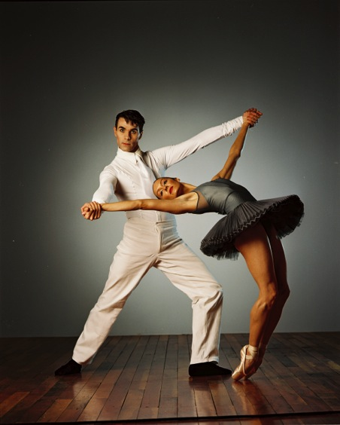
Ihi Frenzy
Photo: Māori Television
Photo: Royal NZ Ballet, Photographer Ross Brown
Notes:
IHI FRENZY
In 2001 Two Icons of NZ culture – the Royal NZ Ballet and national Māori performing arts champions Te Matarae o Rehu – came together in a performance entitled Ihi Frenzy.
Given equal billing, they individually presented a bold programme of work that accentuated the stylistic differences between the two dance forms, show cased the impressive discipline of the dancers and acknowledged important aspects of NZ History. Then they came together in a closing segment and gave a glimpse of the potential to be realised when cultural and artistic differences are mingle in balanced strength.
Mark Baldwin the ballet Choreographer … I actually pinched a lot from Weteni. I ended up using a lot of traditional choreographic moves which, are actually battle plans, or in patters taken from arrowheads or canoes. I was aware of the need to consider protocol and the fact that that we were dealing with a lot of sacred stuff.
Weteni Mitai … I didn’t want our work to be emasculated….

Slide 22
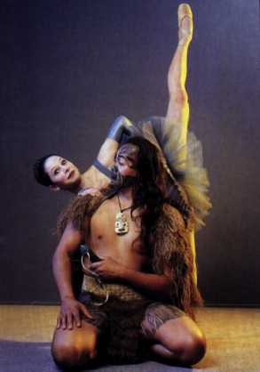
Worlds Brilliantly Balanced
Photo: Mana Magazine 2001, Photographer Kerry Grant
Notes:
IHI FRENZY
In 2001 Two Icons of NZ culture – the Royal NZ Ballet and national Māori performing arts champions Te Matarae o Rehu – came together in a performance entitled Ihi Frenzy.
Given equal billing, they individually presented a bold programme of work that accentuated the stylistic differences between the two dance forms, show cased the impressive discipline of the dancers and acknowledged important aspects of NZ History. Then they came together in a closing segment and gave a glimpse of the potential to be realised when cultural and artistic differences are mingle in balanced strength.
Mark Baldwin the ballet Choreographer … I actually pinched a lot from Weteni. I ended up using a lot of traditional choreographic moves which, are actually battle plans, or in patters taken from arrowheads or canoes. I was aware of the need to consider protocol and the fact that that we were dealing with a lot of sacred stuff.

Slide 23
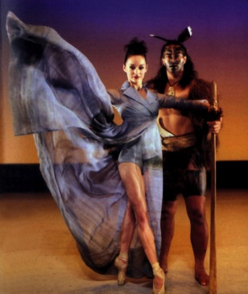
Worlds Brilliantly Balanced
Electrifying meld of cultures
Photo: Mana Magazine 2001, Photographer Kerry Grant
Notes:
IHI FRENZY
In 2001 Two Icons of NZ culture – the Royal NZ Ballet and national Māori performing arts champions Te Matarae o Rehu – came together in a performance entitled Ihi Frenzy.
Given equal billing, they individually presented a bold programme of work that accentuated the stylistic differences between the two dance forms, show cased the impressive discipline of the dancers and acknowledged important aspects of NZ History. Then they came together in a closing segment and gave a glimpse of the potential to be realised when cultural and artistic differences are mingle in balanced strength.
Mark Baldwin the ballet Choreographer … I actually pinched a lot from Weteni. I ended up using a lot of traditional choreographic moves which, are actually battle plans, or in patters taken from arrowheads or canoes. I was aware of the need to consider protocol and the fact that that we were dealing with a lot of sacred stuff.

Slide 24
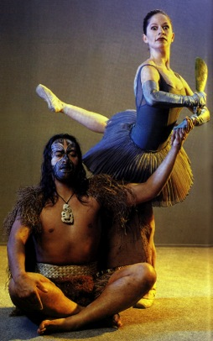
Worlds Brilliantly Balanced
Hot Fusion
Electrifying meld of cultures
Photo: Mana Magazine 2001, Photographer Kerry Grant
Notes:
Conclusion
Indigenous evaluation is fundamentally about how you view the world
That is it’s not about what you do; how you do it, fundamentally about how you view the world and how you know things
But you need to want to be; have a reason to see the world through alternate eyes, do things differently.
Why should I care (and how do I change)
Social justice (Greene, House, Mertens) We as evaluators have been doing evaluation, earning a living and yet we see no visible difference in the outcomes for Aboriginal peoples. Negative Stats
Ethic of care - do no harm - example where evaluation has or continues to do harm to Indigenous peoples
Multi cultural validity (Kirkhart, La France, Nichols)- centring validity arguments in culture (Kirkhart, 2013); validity located within culture, context and values;
How do I change – paradigm change
Need to begin to understand and engage with different cultural paradigms – what this means for our ways of working
Indigenous Evaluation Framework - for assessing our evaluation practice and ways of working with Indigenous peoples and communities
To, For, With, By, As

Slide 25
Acknowledgements
To my colleagues Kate McKegg, Judy Oakden and Julian King
To Lois-ellin Datta
To my daughters Teia and Kahiwa Sebire
Nan Wehipeihana
nan@kinnect.co.nz
nan.wehipeihana@gmail.com
Notes:
Conclusion
Indigenous evaluation is fundamentally about how you view the world
This is It’s not about what you do; how you do it, fundamentally about how you view the world and how you know things
But you need to want to be; have a reason to see the world through alternate eyes, do things differently.
Why should I care (and how do I change)
Social justice (Greene, House, Mertens) We as evaluators have been doing evaluation, earning a living and yet we see no visible difference in the outcomes for Aboriginal peoples. Negative Stats
Ethic of care - do no harm - example where evaluation has or continues to do harm to Indigenous peoples
Multi cultural validity (Kirkhart, La France, Nichols)- centring validity arguments in culture (Kirkhart, 2013); validity located within culture, context and values;
How do I change – paradigm change
Need to begin to understand and engage with different cultural paradigms – what this means for our ways of working
Indigenous Evaluation Framework - for assessing our evaluation practice and ways of working with Indigenous peoples and communities
To, For, With, By, As

